Slide 1
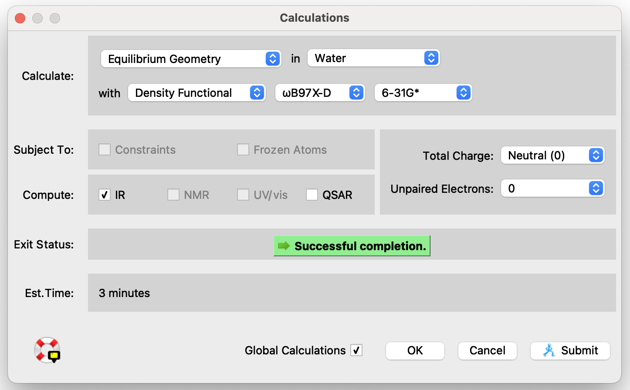
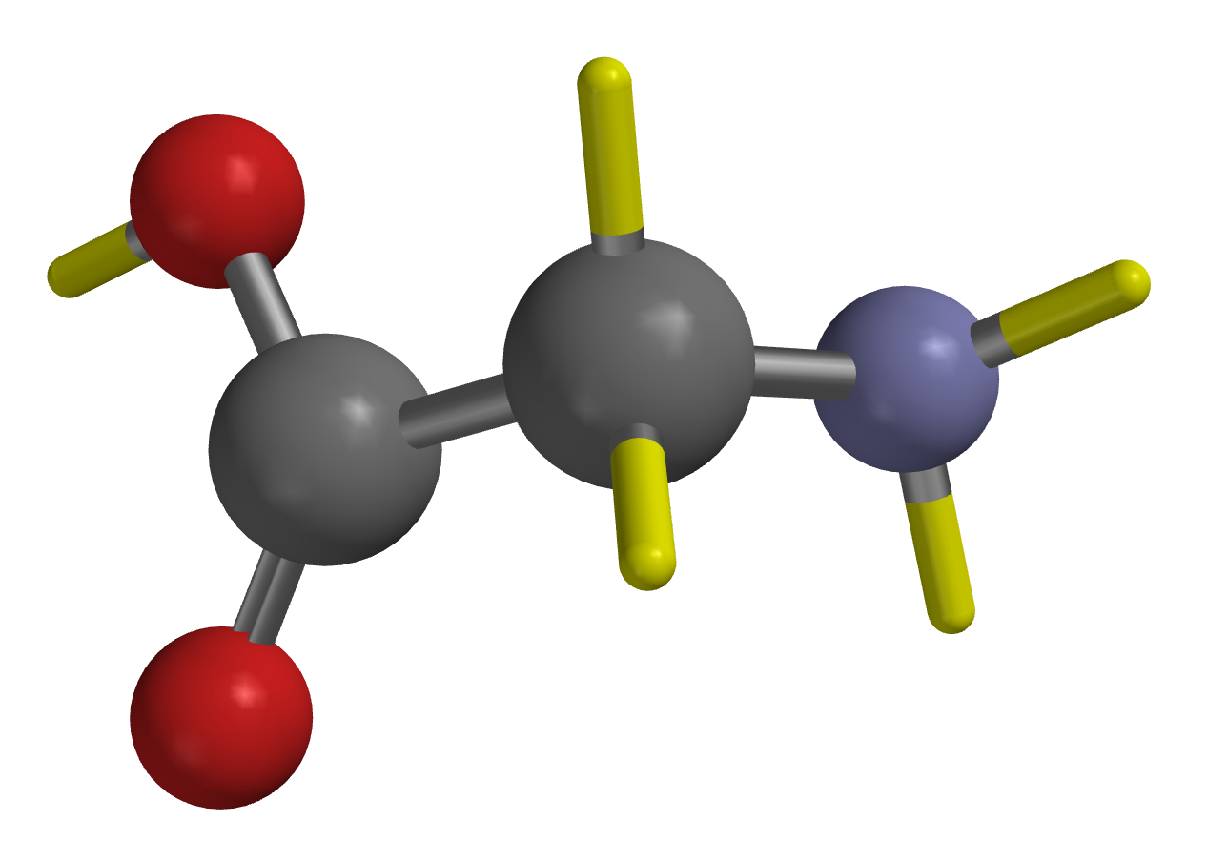

Frequency of the $R−NH_{2}$ (scissor) vibration in the high-temperature limit
Specify Equilibrium Geometry, Water, and IR
Yellow lines default to Hydrogens (so you don’t have to add them explicitly)

Slide 2
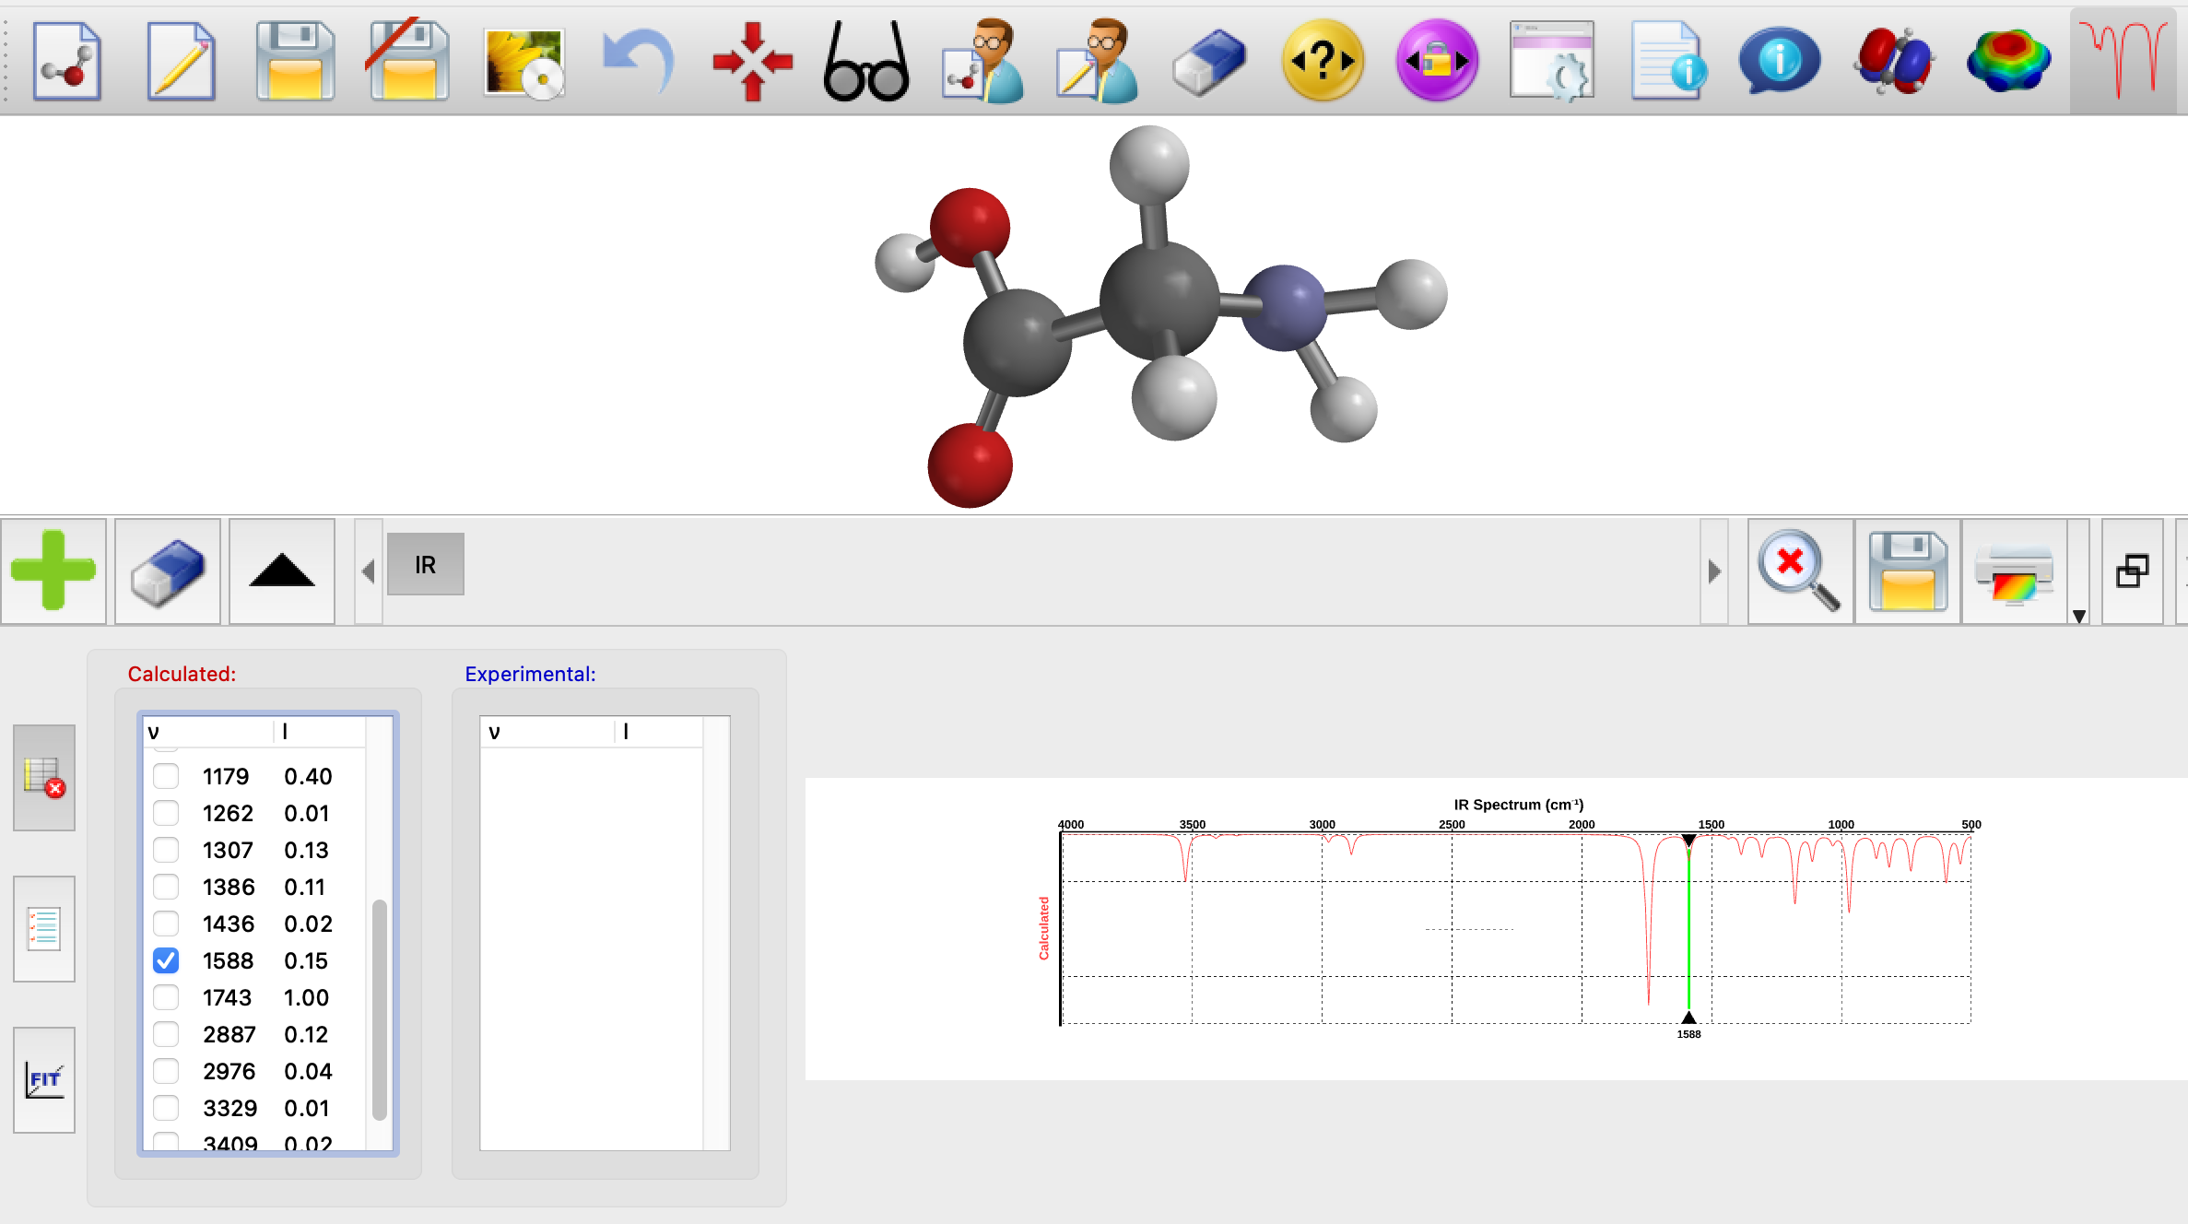

Frequency of the $R−NH_{2}$ (scissor) vibration in the high-temperature limit
$${\overline{ν}}_{HT}$$

Slide 3
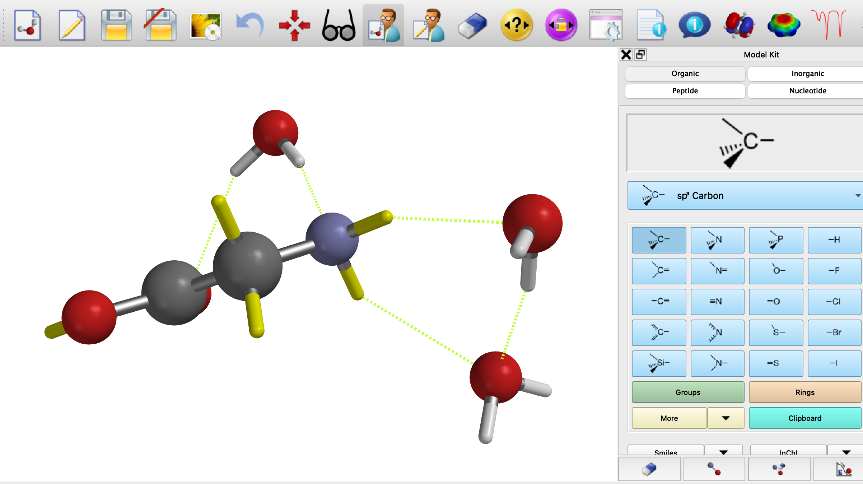
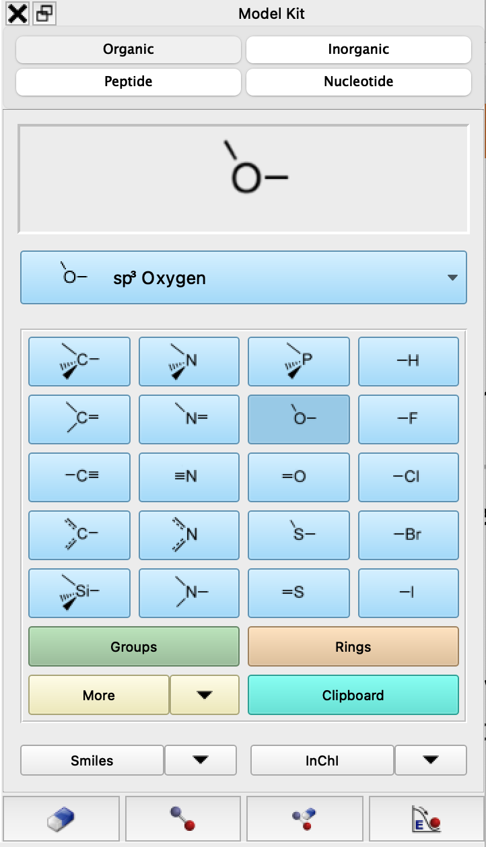
Frequency of the $R−NH_{2}$ (scissor) vibration in the low-temperature limit
Set-up procedure:
Position 4-5 water molecules around the solute.
Display H-bonds using the Model dropdown menu.
Minimize energy to get a configuration with least three H-bonds to the amine.
Delete non H-bonding water molecules before proceeding to the quantum calculation.
You’ll probably have to iterate this procedure a few times because the solvent water molecules move around when you minimize.

Slide 4
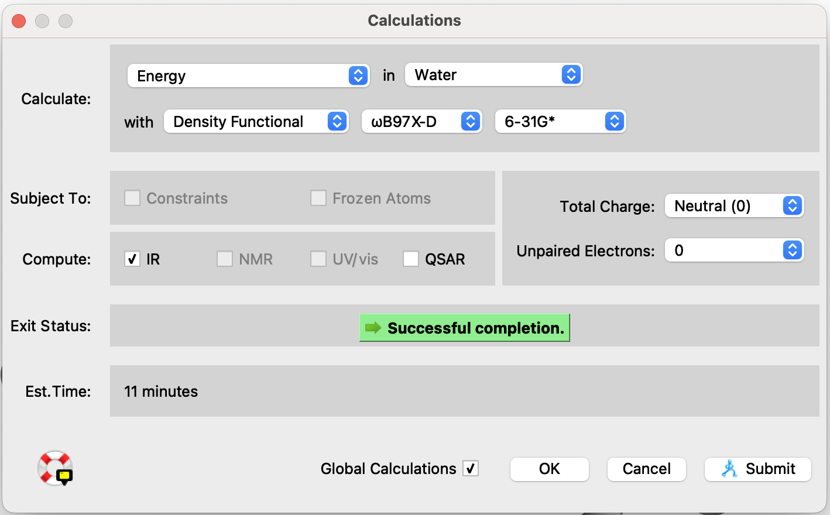
Frequency of the $R−NH_{2}$ (scissor) vibration in the low-temperature limit
Change Equilibrium Geometry to Energy
The calculation will move along a lot faster if you choose “Energy” (rather than the default, “Equilibrium Geometry”) here.

Slide 5
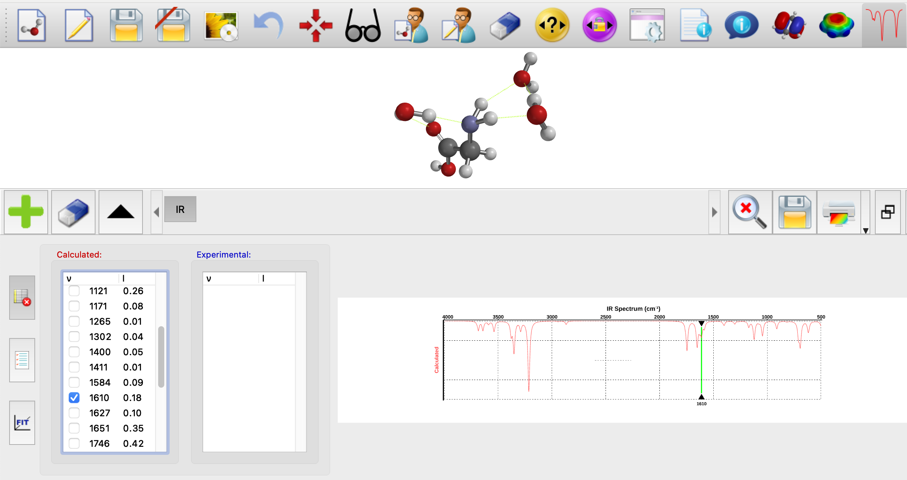

Frequency of the $R−NH_{2}$ (scissor) vibration in the low-temperature limit
$${\overline{ν}}_{LT}$$

